Slide 1
GAN: Generative Adversial Network
Swadhin Pradhan
(Slides taken from Fei Fei Li and Ian Goodfellow et. al)

Slide 2
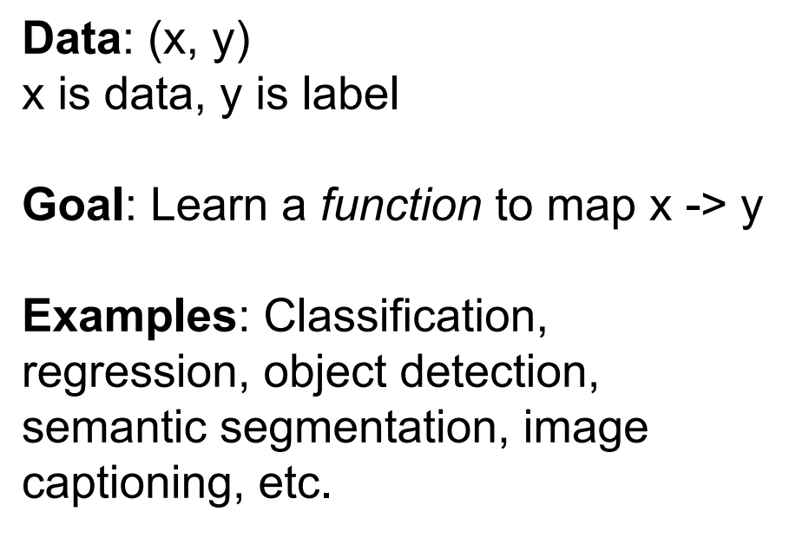
Supervised Learning

Slide 3
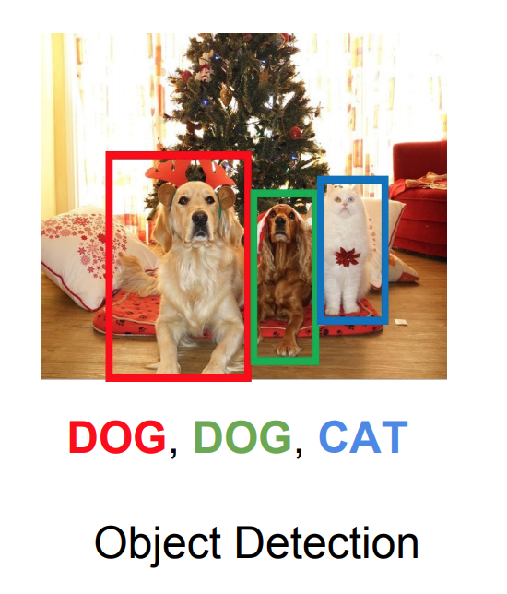
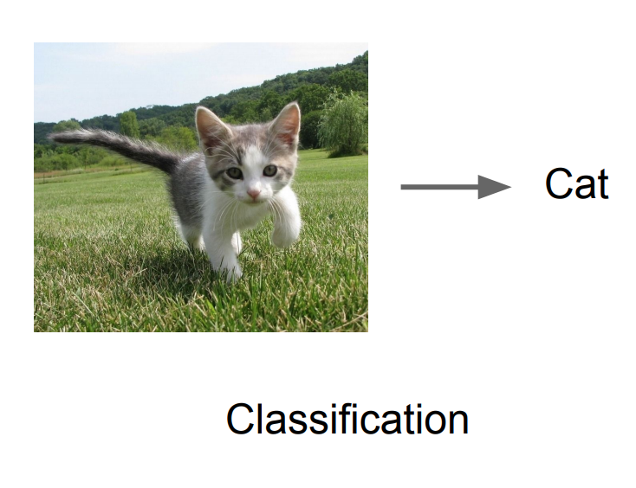
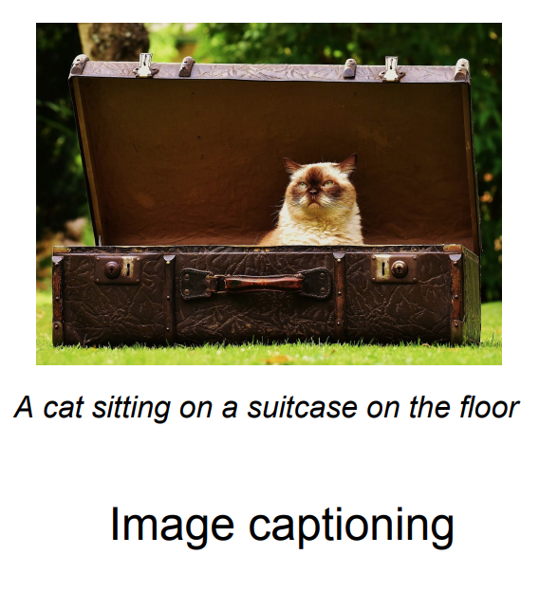
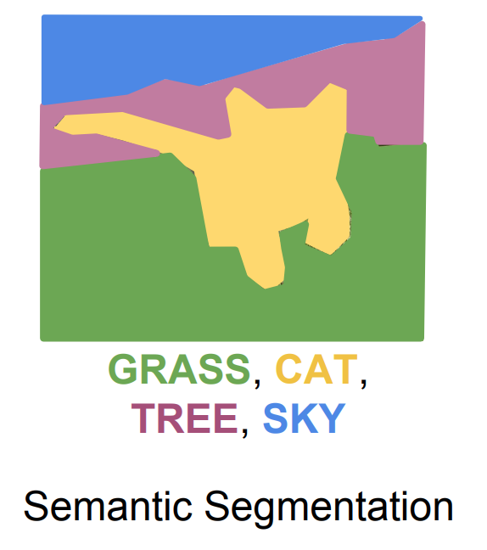
Supervised Learning

Slide 4
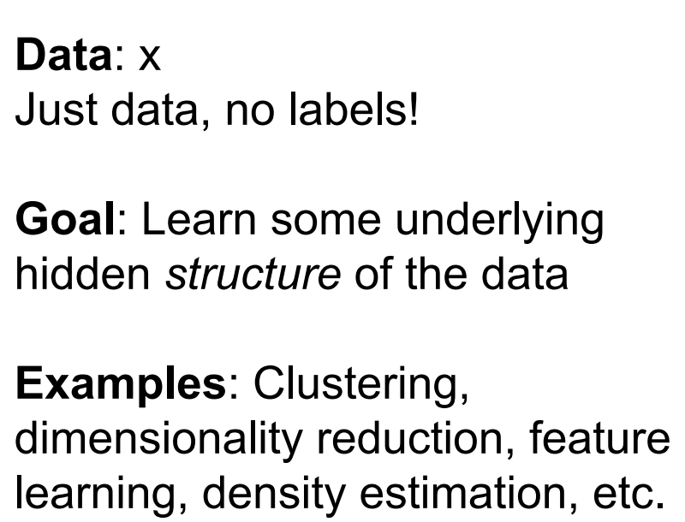
Unsupervised Learning

Slide 5
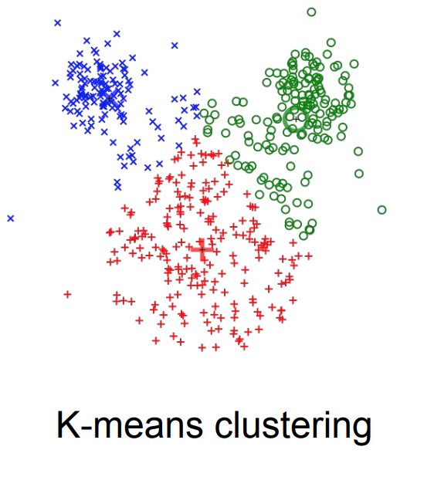
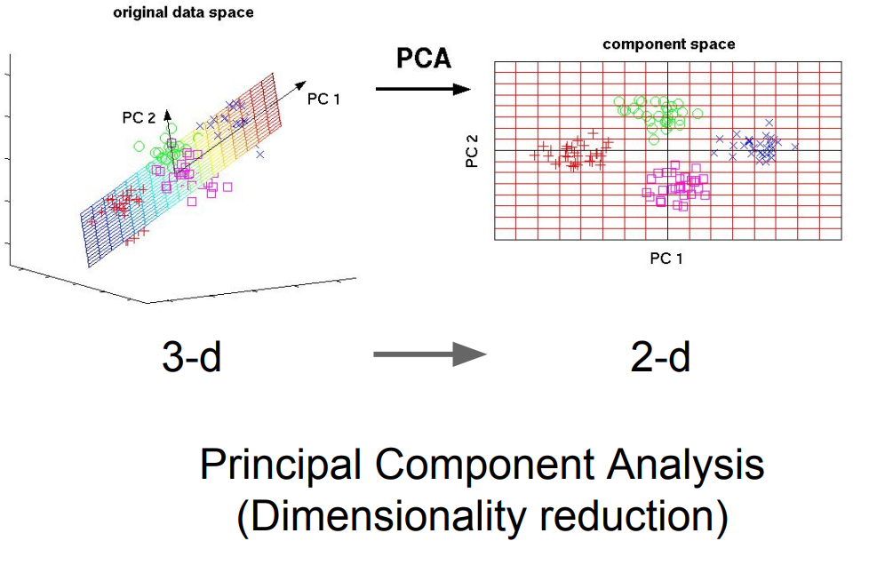
Unsupervised Learning

Slide 6
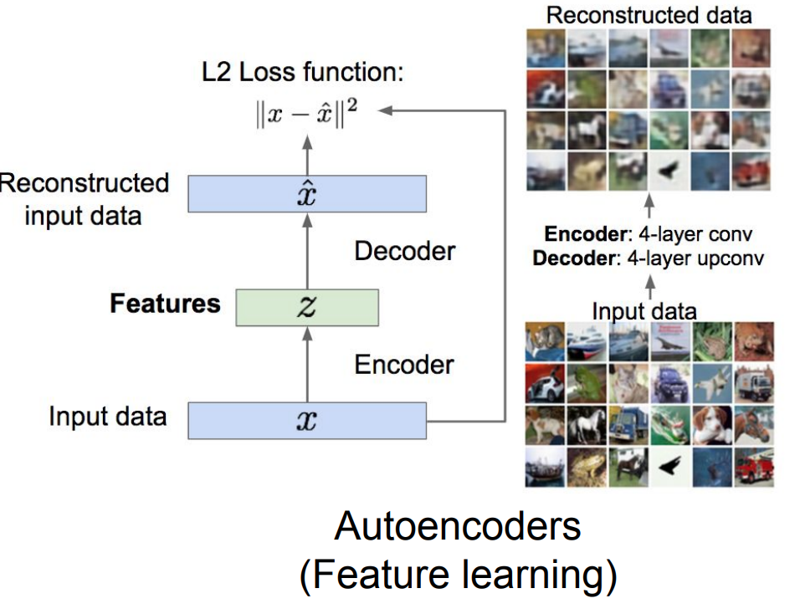
Unsupervised Learning

Slide 7
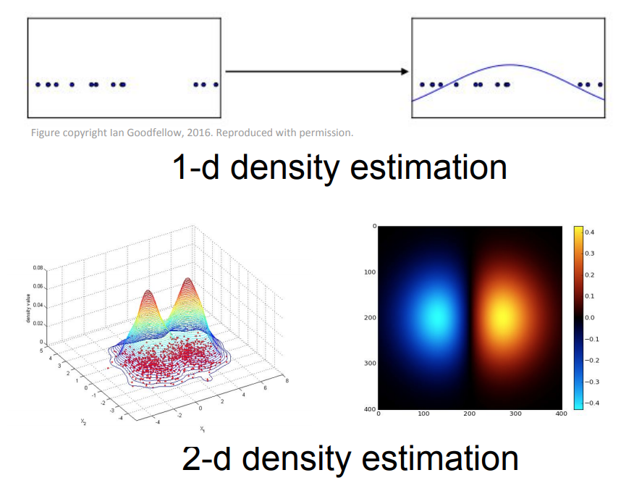
Unsupervised Learning

Slide 8
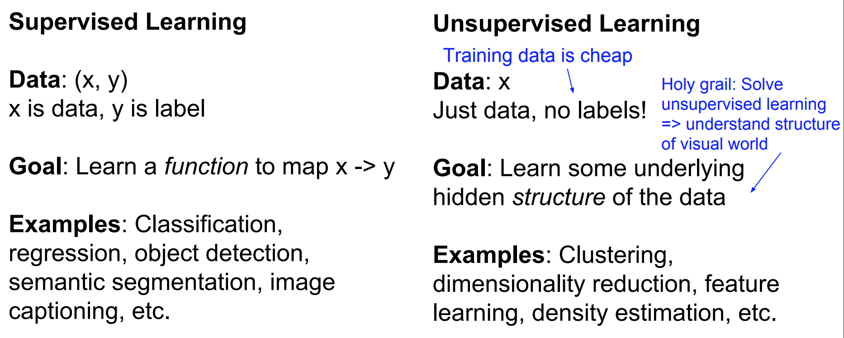
Supervised vs Unsupervised Learning

Slide 9
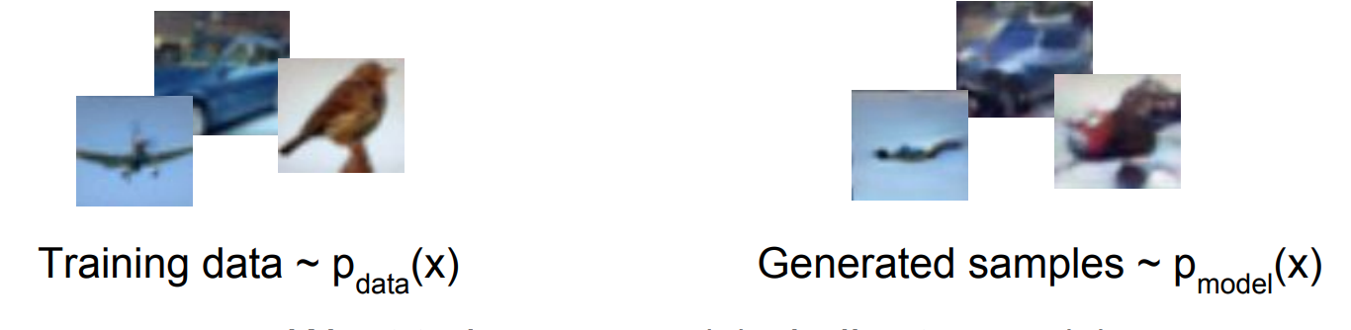
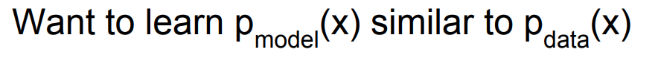
Generative Model [ P(y|x) -> P(x|y) ]

Slide 10
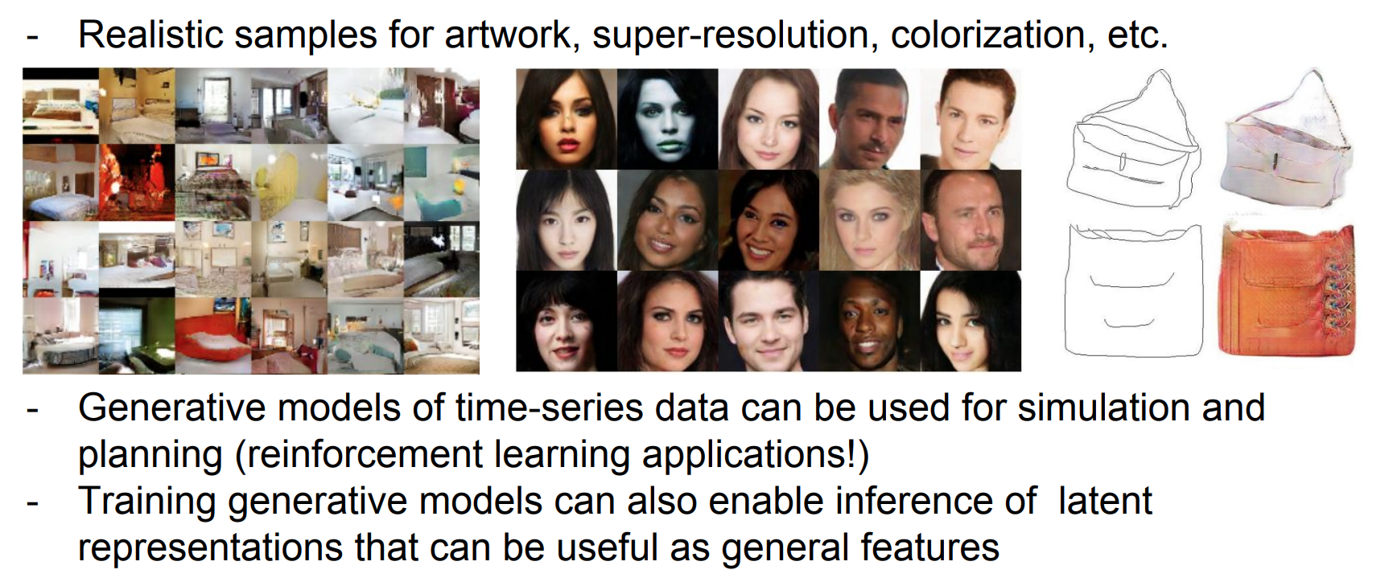
Why Generative Models ?

Slide 11
Types of Generative Models
Given a label, they predict the associated features (Naive Bayes)
Given a hidden representation, they predict the associated features (VAE, GAN)
Given some of the features, they predict the rest (inpainting, imputation)

Slide 12
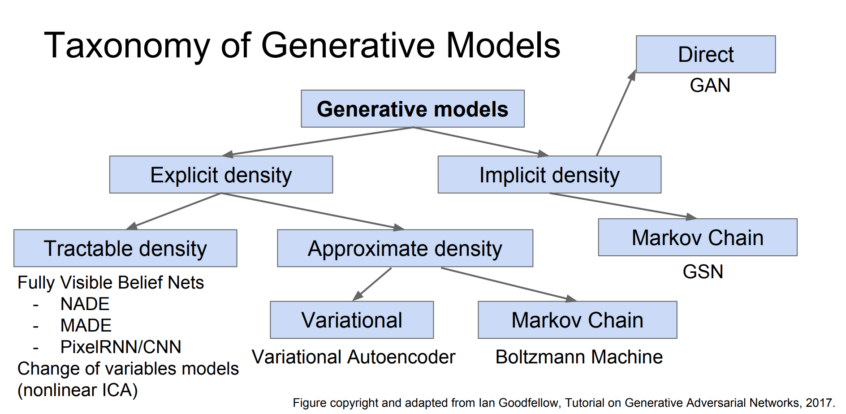

Slide 13
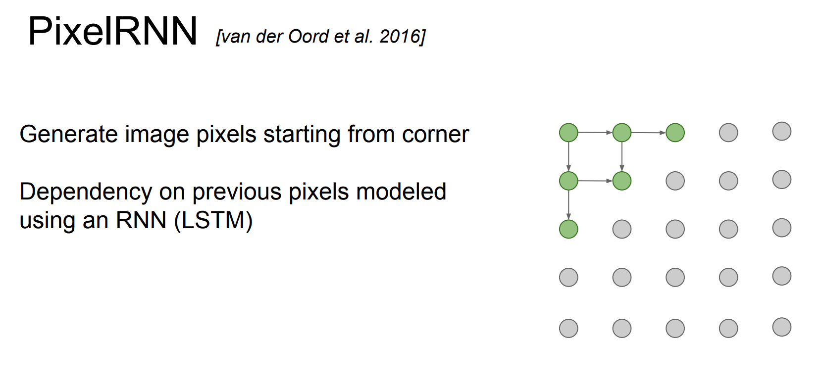

Slide 14
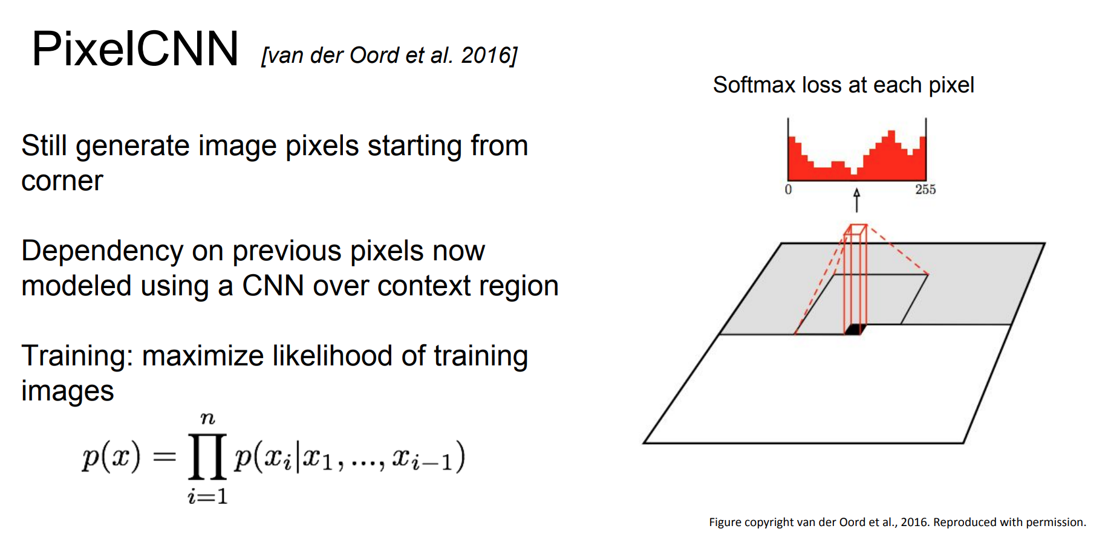

Slide 15
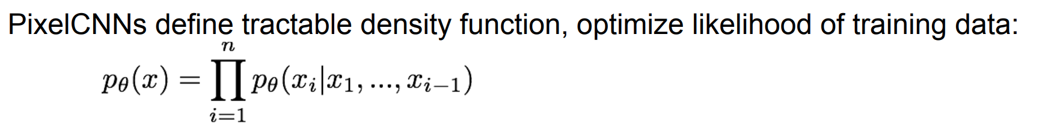
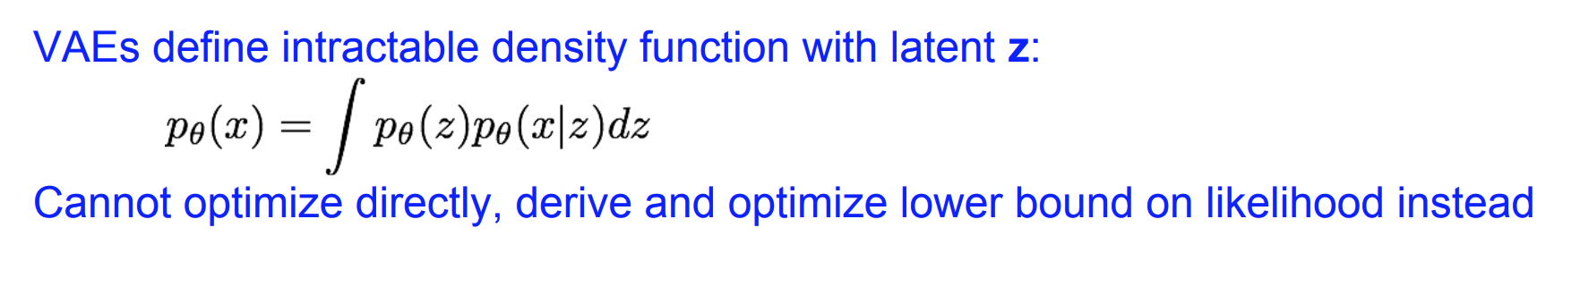
Variational Autoencoders (VAE)

Slide 16
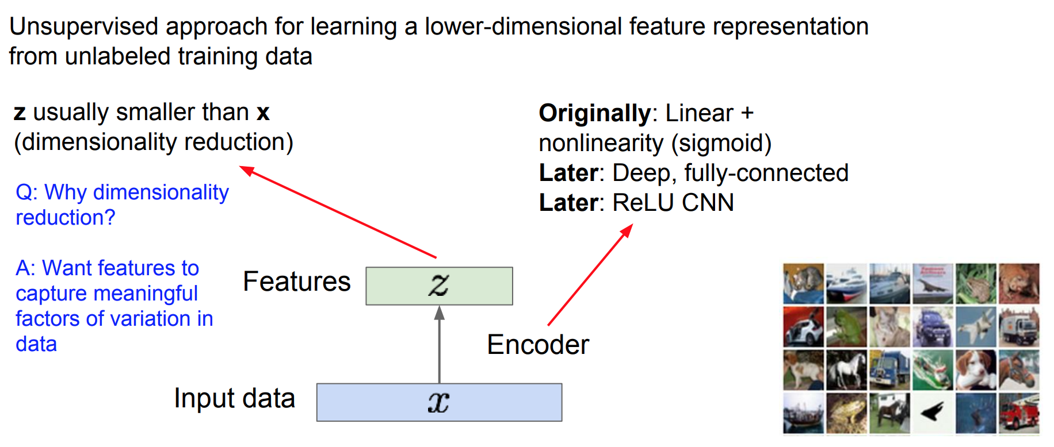
Autoencoders

Slide 17
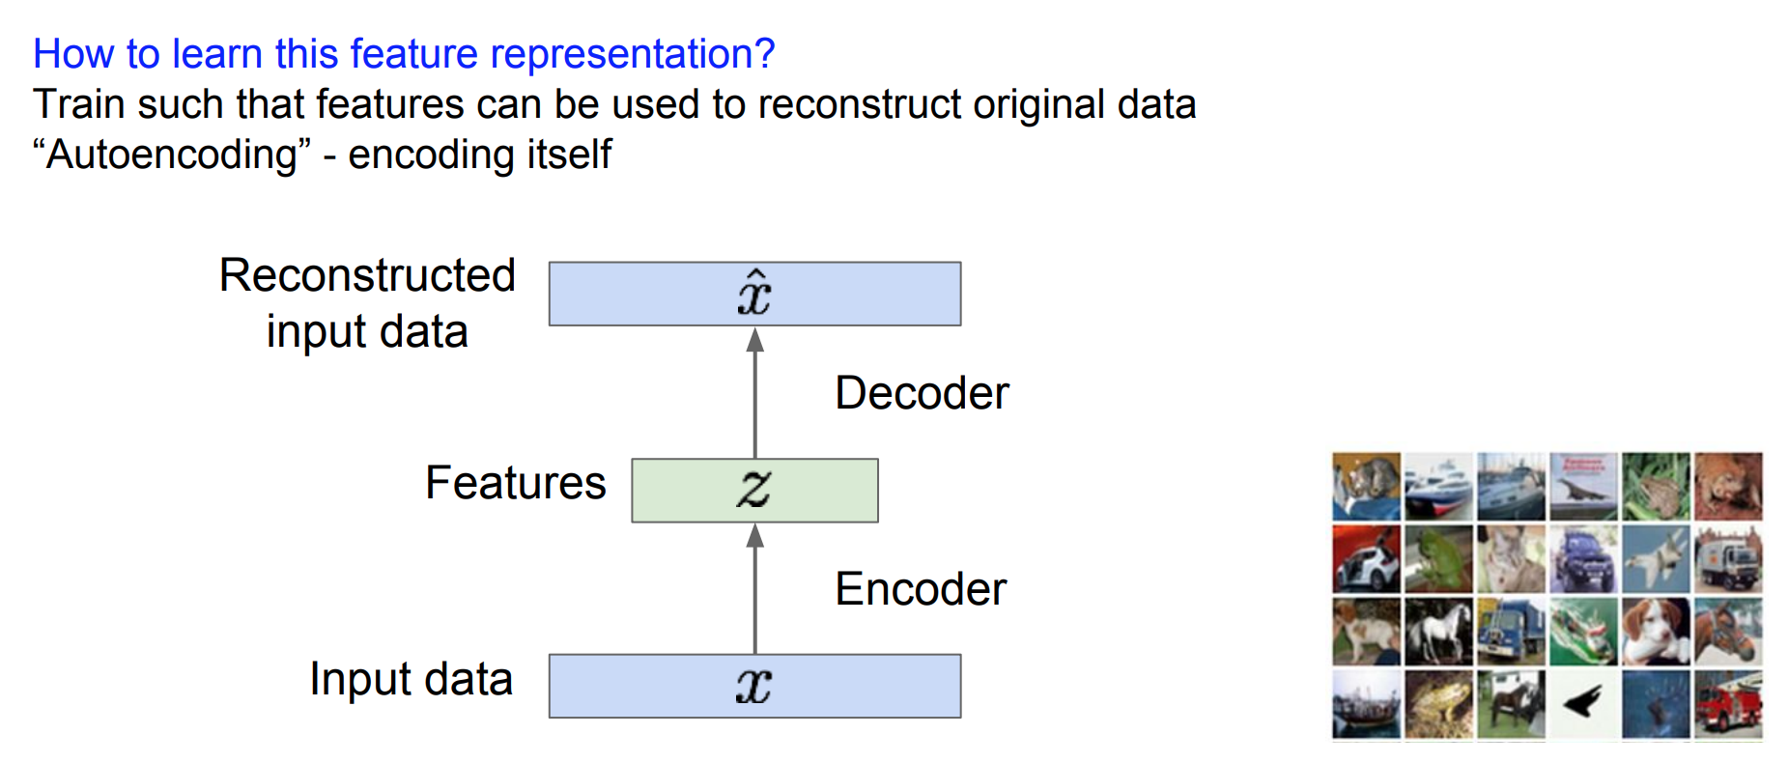
Autoencoders

Slide 18
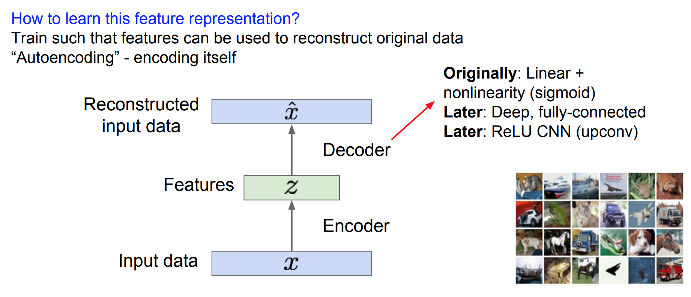
Autoencoders

Slide 19
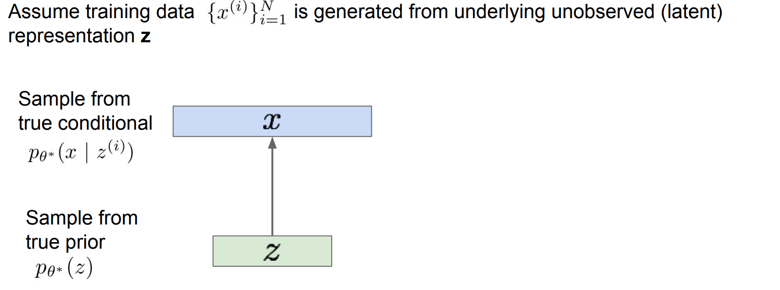
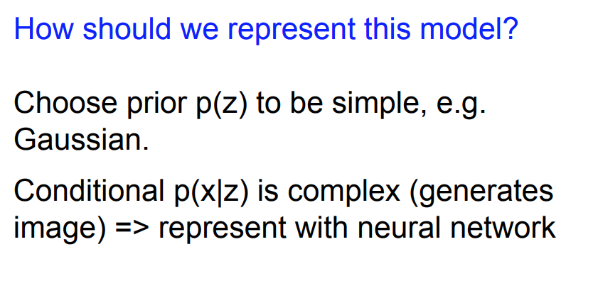
Variational Autoencoders

Slide 20
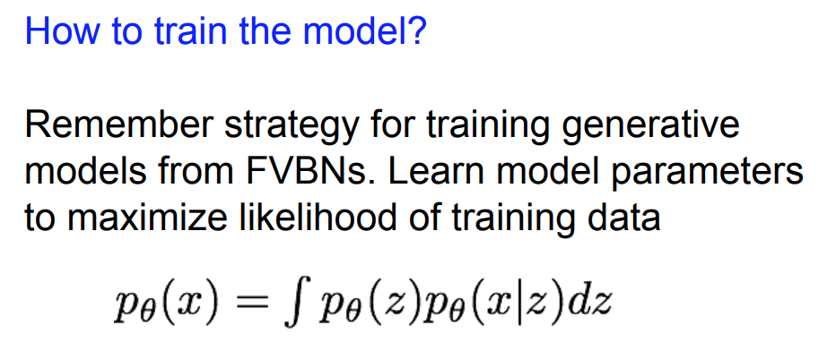
Variational Autoencoders

Slide 21
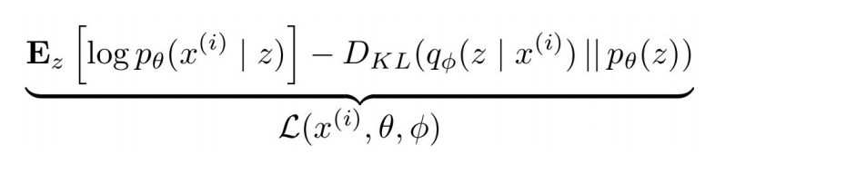
Variational Autoencoders

Slide 22
Autoencoder
NN
Encoder
NN
Decoder
Minimize reconstruction error
input
output
code
VAE
m₁
m₂
NN
Encoder
m₃
c₁
NN
Decoder
exp
+
c₂
output
σ₁
σ₂
c₃
σ₃
X
c_{i} = exp(σ_{i})e_{i} + m_{i}
From a normal distribution
e₁
Minimize
e₂
e₃
Σ_{i=1..3} [exp(σ_{i})−(1+σ_{i})+(m_{i})² ]
Auto-Encoding Variational Bayes, https://arxiv.org/abs/1312.6114
This constrains σ_{i} approacing 0 is good

Slide 23
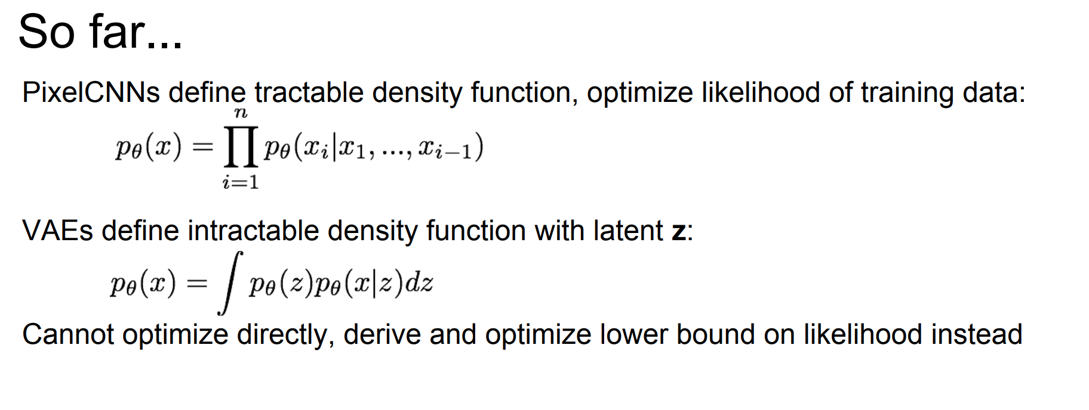
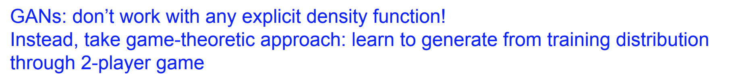
Generative Adversial Networks

Slide 24
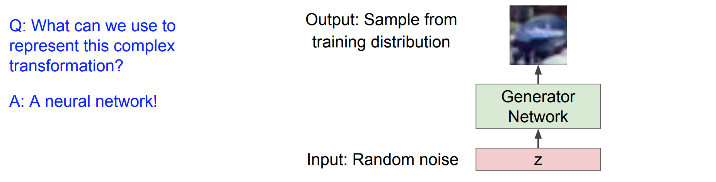
GAN

Slide 25
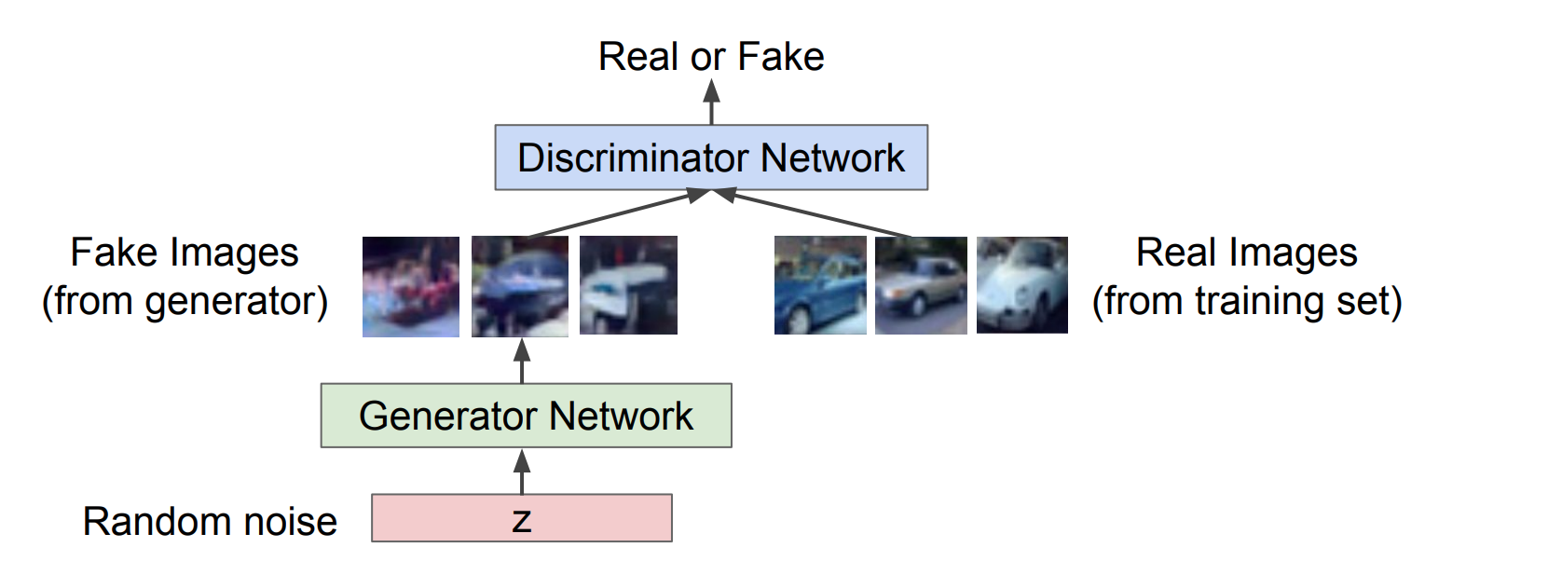
GAN: Two Player Game

Slide 26
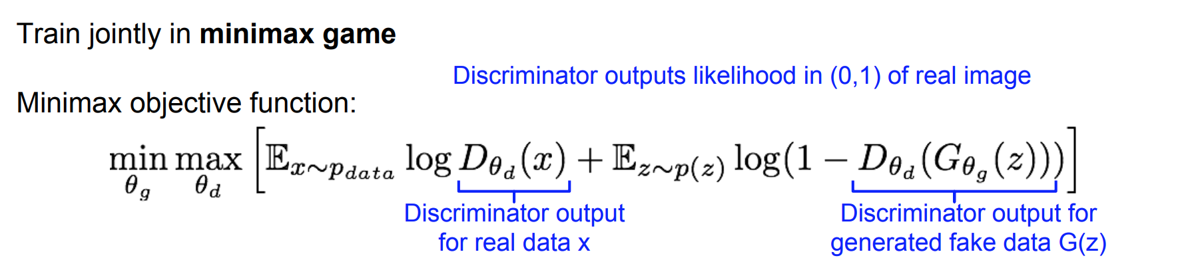
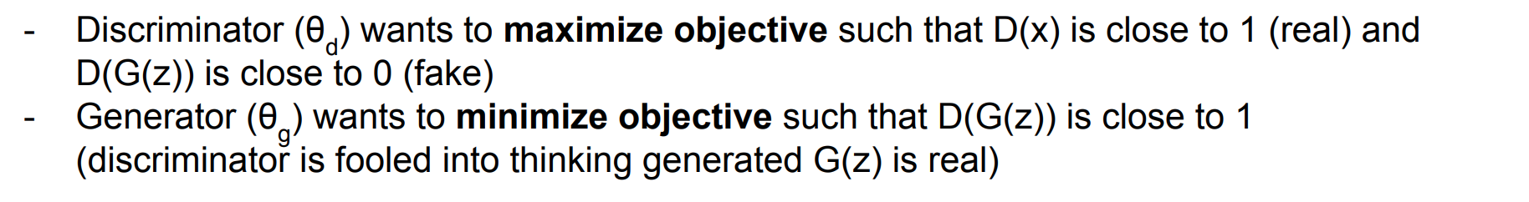
Training GAN: Two Player Game

Slide 27
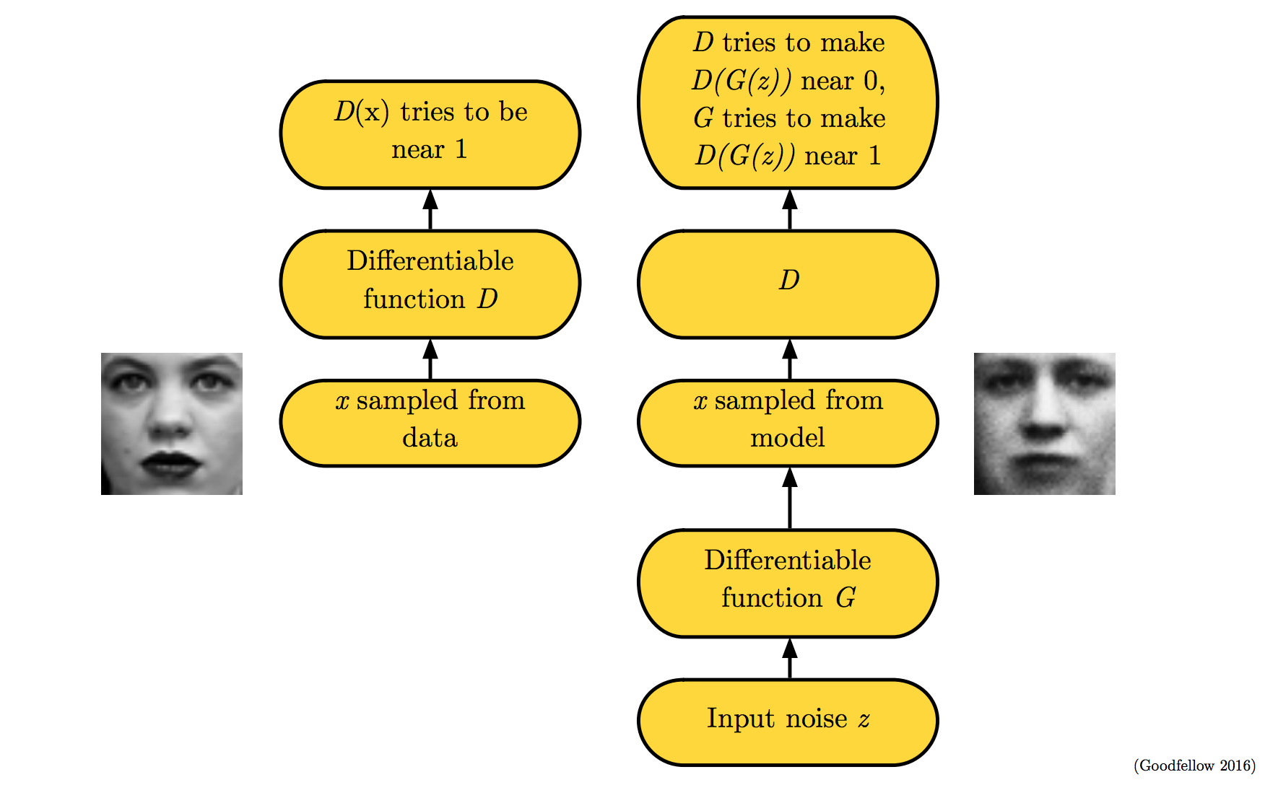

Slide 28
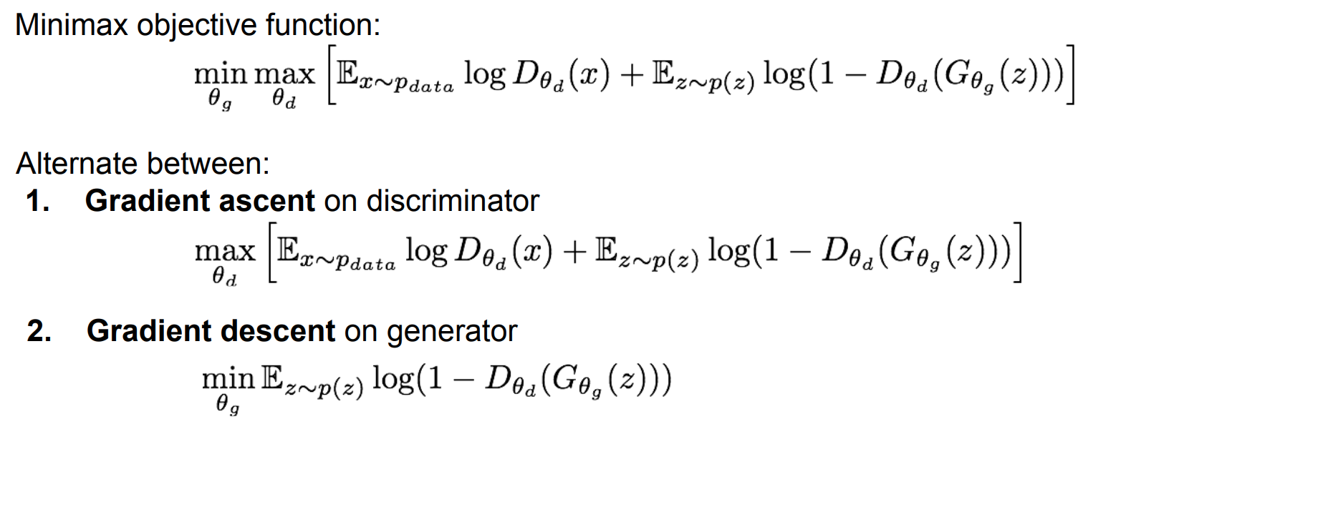
Training GAN: Two Player Game

Slide 29
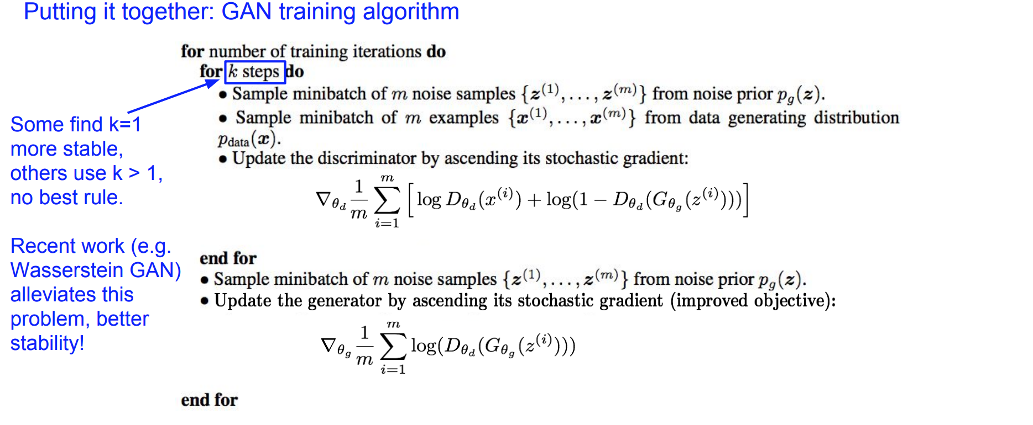
Training GAN

Slide 30
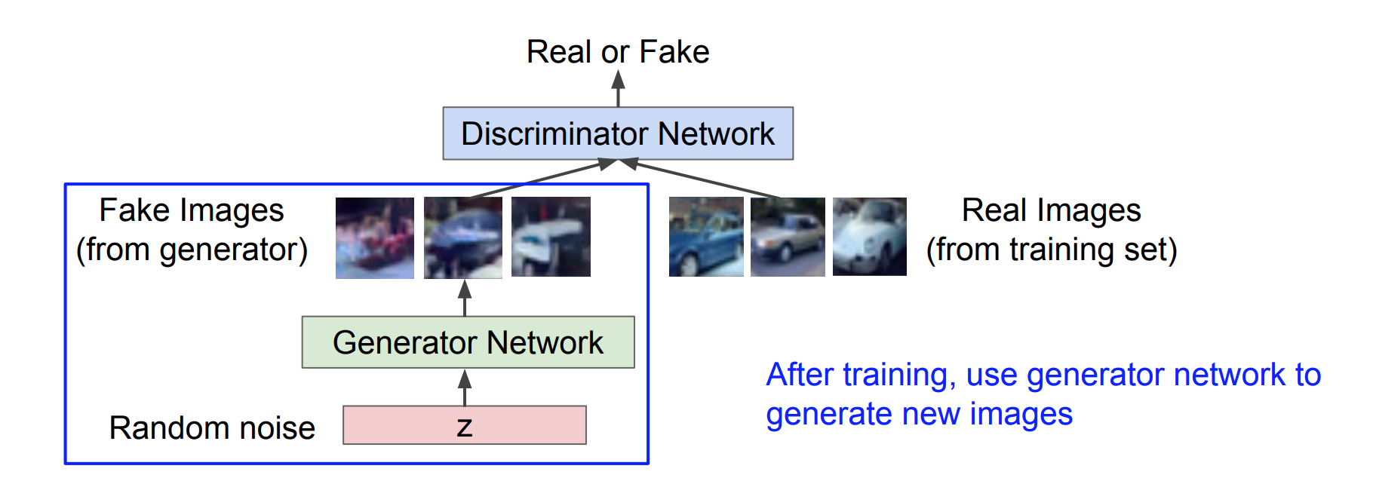
GAN

Slide 31
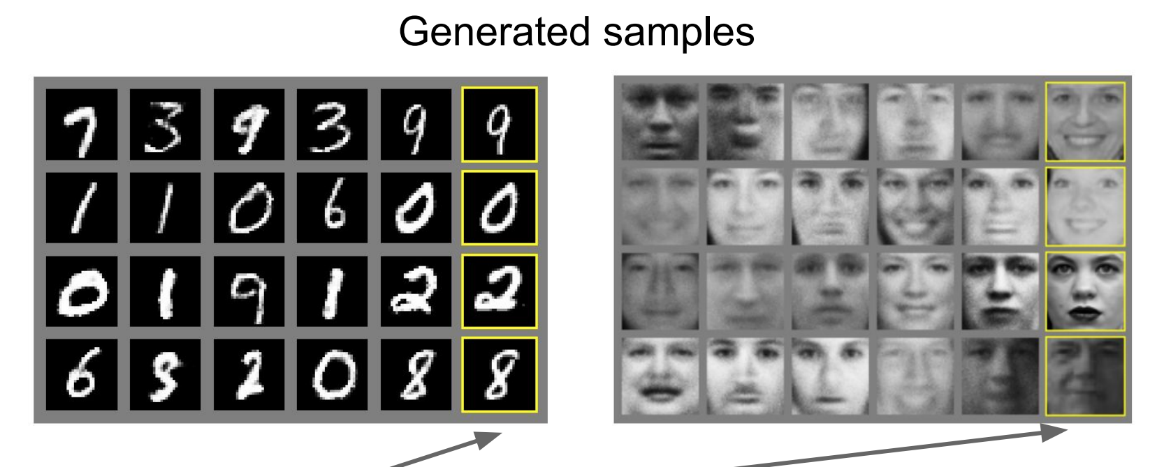
Examples

Slide 32
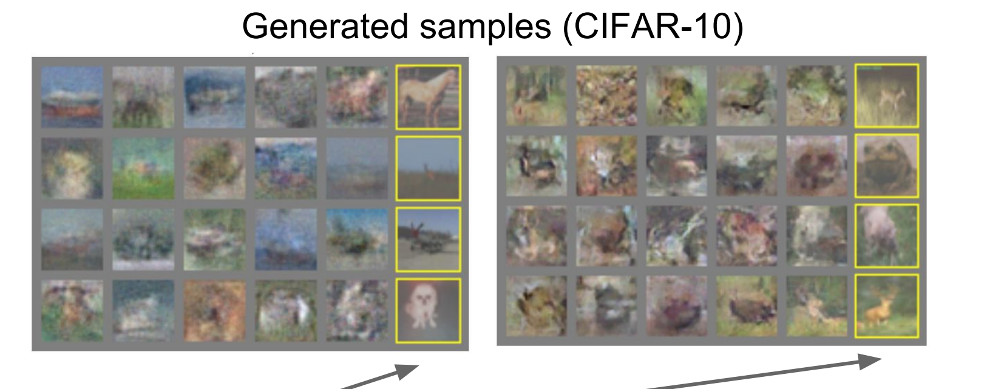
Examples

Slide 33
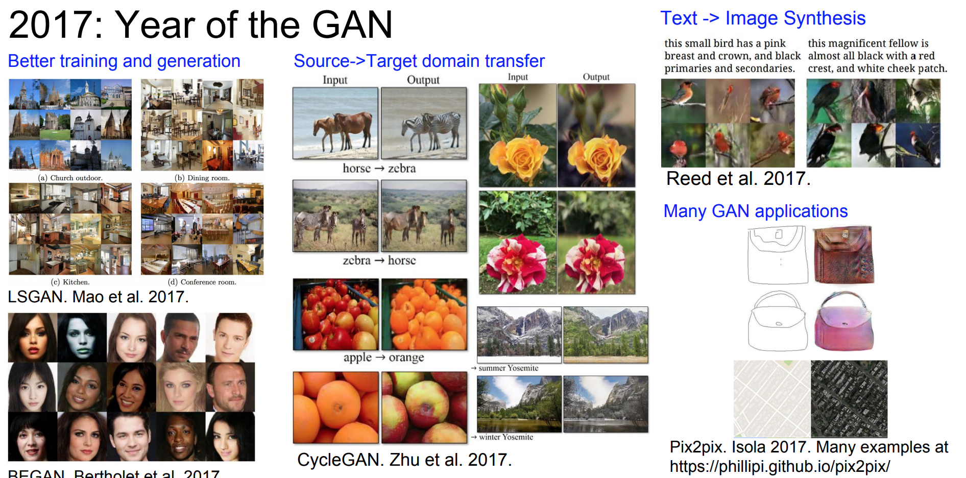

Slide 34
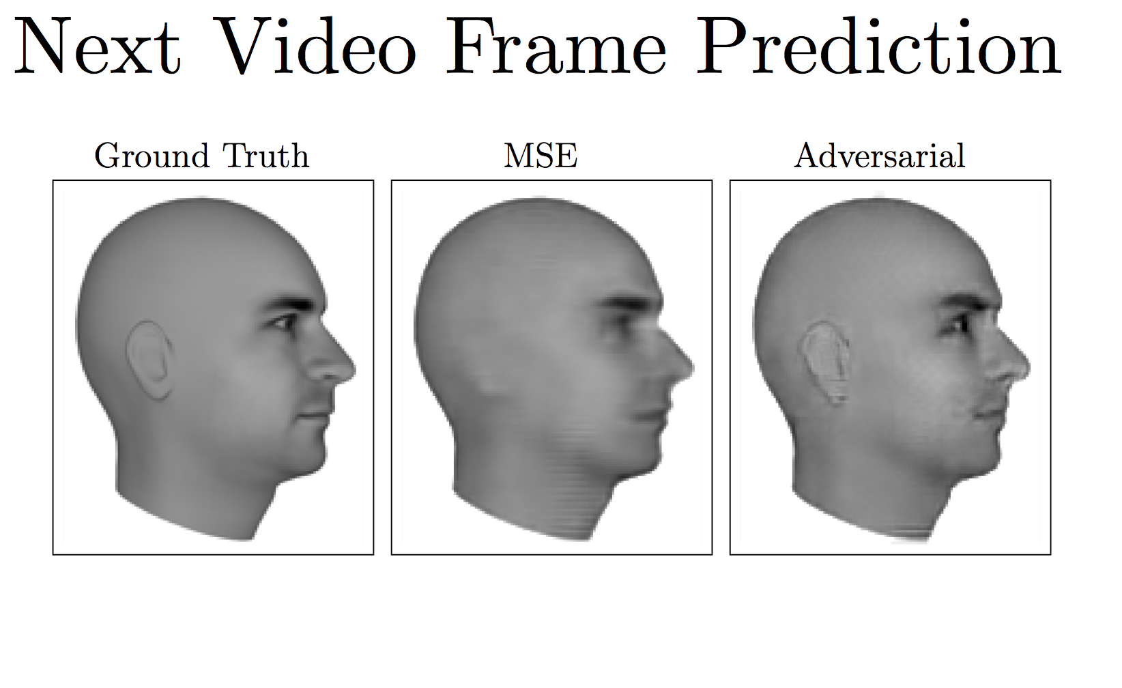
Another Application

Slide 35
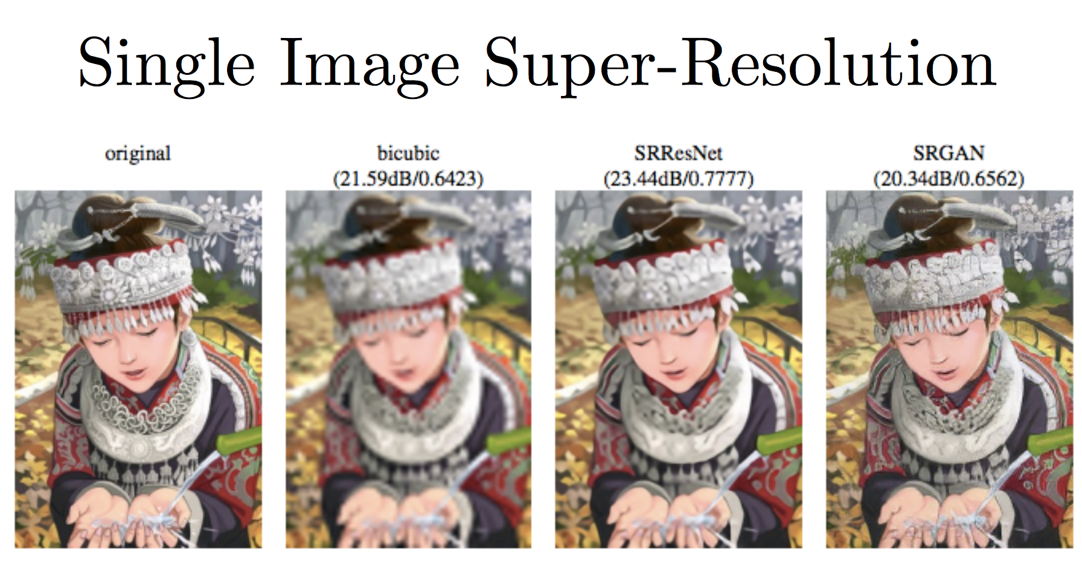
Another Application

Slide 36
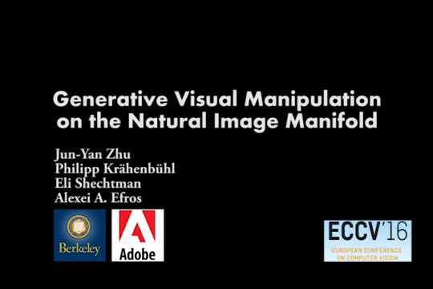
Interesting Example

Slide 37
GAN Zoo Link and GAN Hack
https://github.com/hindupuravinash/the-gan-zoo
https://github.com/soumith/ganhacks/
http://www.iangoodfellow.com/slides/2016-12-04-NIPS.pdf

Slide 38
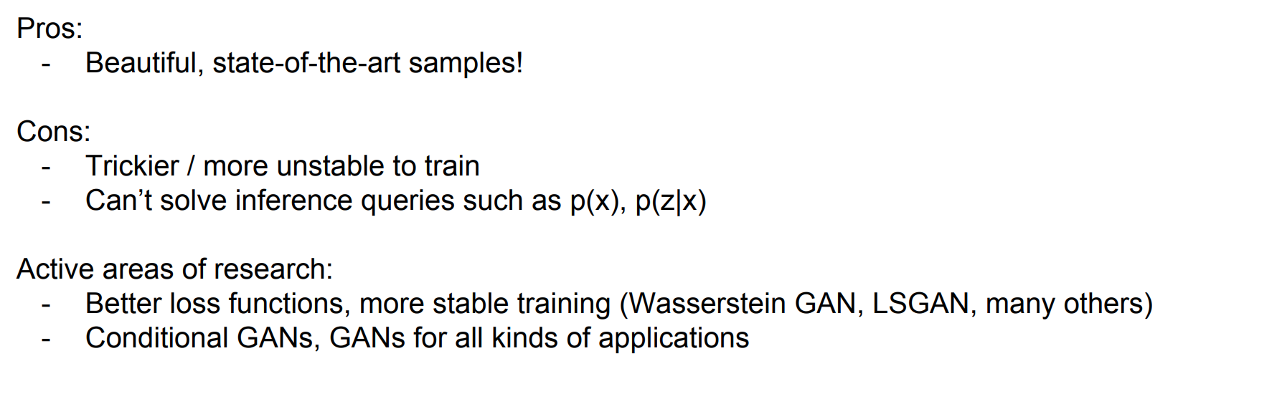
GANs

